Slide 1
H20: Hydration and You

Slide 2
2/3
Of your body is made of
water

Slide 3
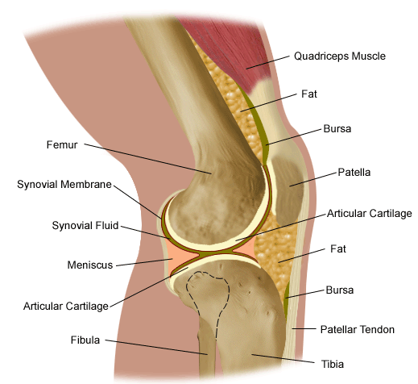
Water
Transports nutrients
Removes waste
Hydrates skin
Lubricates joints
Moistens
Aids in digestion

Slide 4
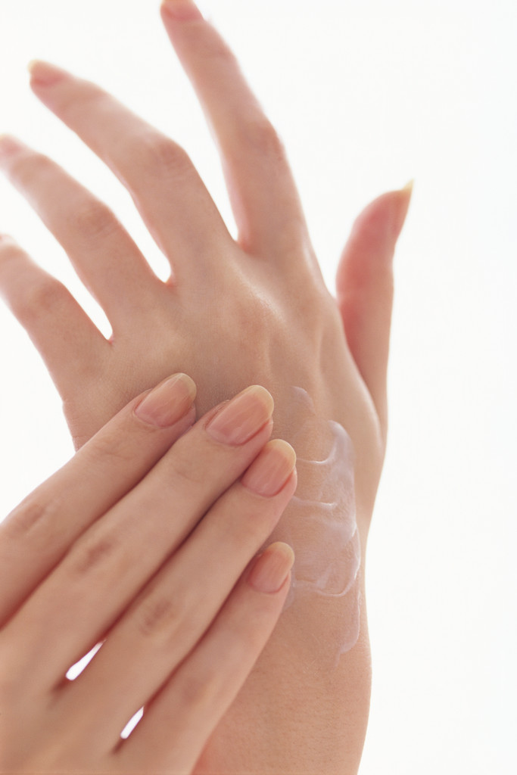
Water Maintains
- blood volume
- body fluids
- body temperature
- healthy skin

Slide 5
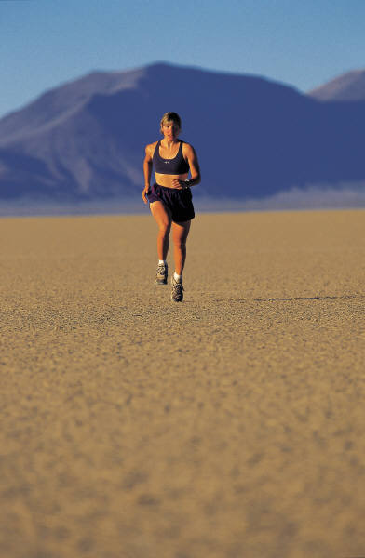
H20… where does it go?
Urination
Vomiting or diarrhea
Sweating/perspiration
Breathing

Slide 6
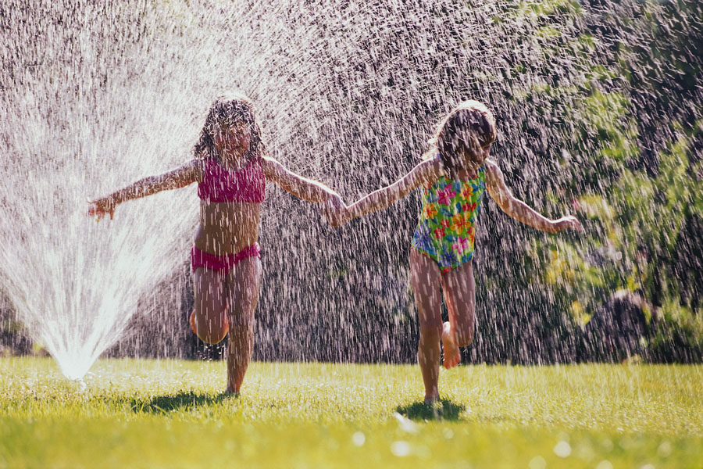
Dehydration
Not having enough water for your body to do what it needs to do

Slide 7
Dehydration: Signs and Symptoms
Dry mouth
Dizziness
Weakness
Muscle cramps
Weak or rapid pulse
Confusion
Sluggishness/ daytime fatigue

Slide 8
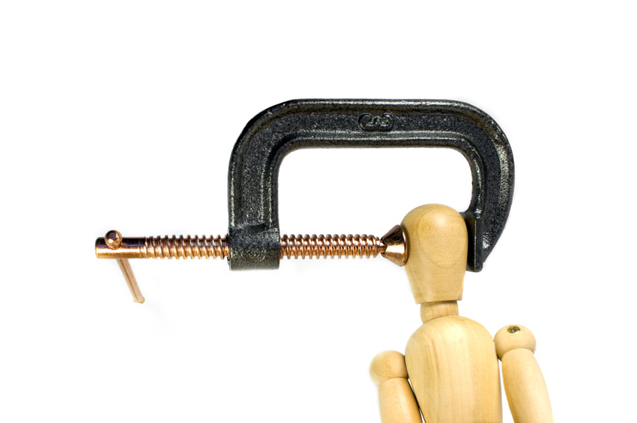
Dehydration: signs and symptoms
Fainting
Inability to sweat
Decreased urine output
Short-term memory trouble
Focusing issues
Headaches

Slide 9
Being hydrated affects your physical and mental performance every day.

